Slide 1
REST API
Olívia Michalovič
Notes:
Footer

Slide 2
What is API?
An application programming interface (API)
,,Gateway between clients and resources on the web.”
USER API RESOURCES
want to access information that
information different applications
from the web provide to their clients.
Notes:
Footer

Slide 3
What is REST?
Representational State Transfer (REST).
Software architecture that imposes conditions on how an API should work.
Guideline to manage communication on a complex network.
Easily implement and modify.
APIs that follow the REST architectural style are called REST APIs.
Web services that implement REST architecture are called RESTful web services.
Notes:
Footer

Slide 4
REST architectural style
Uniform interface - server transfers information in a standard format.
Statelessness - communication method in which the server completes every client request independently of all previous requests.
Layered system - client can connect to other authorized intermediaries between the client and server, and it will still receive responses from the server.
Cacheability – process of storing some responses on the client or on an intermediary to improve server response time.
Code on demand - temporarily extend or customize client functionality by transferring software programming code to the client.
Notes:
Footer

Slide 5
Benefits of RESTful APIs.
Scalability - scale efficiently because REST optimizes client-server interactions.
Flexibility - support total client-server separation.
Independence - independent of the technology used.
Notes:
Footer

Slide 6
How do RESTful APIs work?
Server receives the request and processes it internally.
Client sends a request
to the server.
Server authenticates the client.
Server returns a response to the client.
Notes:
Footer

Slide 7
What does the RESTful API client request contain?
Unique resource identifier - The server identifies each resource with unique resource identifiers(URL). The URL specifies the path to the resource.
Method - An HTTP method tells the server what it needs to do to the resource.
Notes:
Footer

Slide 8
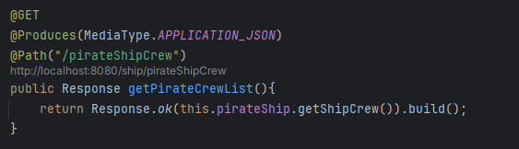
@GET
Access resources that are located at the specified URL on the server.
Possibility to send parameters in the RESTful API request.
Notes:
Footer

Slide 9
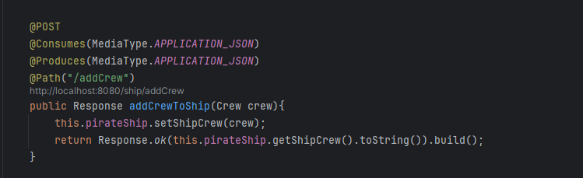
@POST
Send data to the server.
Include the data representation with the request.
Multiple POST can create the same resource multiple times.
Notes:
Footer

Slide 10
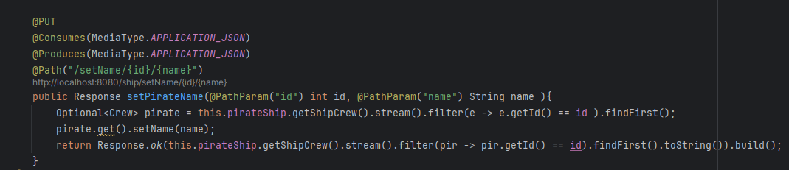
@PUT
Update existing resources on the server.
Possibility to send parameters in the RESTful API request.
@PathParam is a parameter annotation which allows you to map variable URI path fragments into your method call.
Notes:
Footer

Slide 11
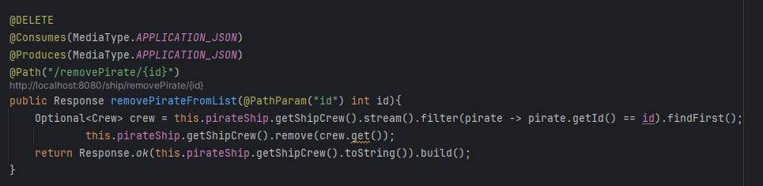
@DELETE
Remove the resource.
Notes:
Footer

Slide 12
HTTP headers
Metadata exchanged between the client and server.
Indicates the format of the request and response, provides information about request status,…
(https://developer.mozilla.org/en-US/docs/Web/HTTP/Status)
Notes:
Footer

Slide 13
Data
REST API requests might include data for the POST, PUT, and other HTTP methods to work successfully.
Notes:
Footer

Slide 14
Parameters
Path parameters.
Query parameters.
Cookie parameters.
Notes:
Footer

Slide 15
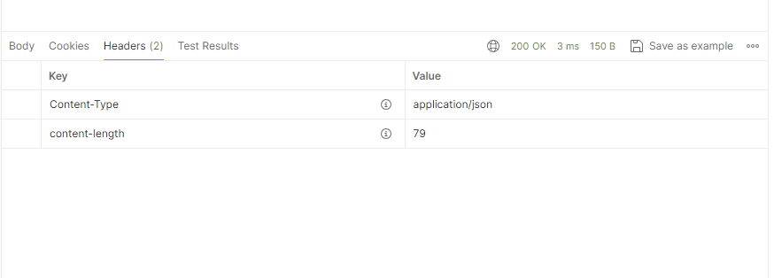
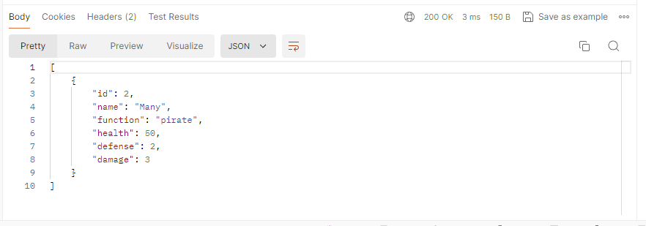
REST API response
Status line – HTTP status codes.
Message body - XML or JSON formats.
Headers - headers or metadata about the response.
Notes:
Footer

Slide 16
HANDS ON
<dependency>
<groupId>jakarta.ws.rs</groupId>
<artifactId>jakarta.ws.rs-api</artifactId>
<version>3.1.0</version>
</dependency>
<dependency>
<groupId>io.quarkus</groupId>
<artifactId>quarkus-resteasy-multipart</artifactId>
</dependency>
<dependency>
<groupId>io.quarkus</groupId>
<artifactId>quarkus-resteasy-client-jackson</artifactId>
</dependency>
<dependency>
<groupId>io.quarkus</groupId>
<artifactId>quarkus-resteasy-client</artifactId>
<version>3.11.0</version>
</dependency>
<dependency>
<groupId>org.projectlombok</groupId>
<artifactId>lombok</artifactId>
<version>1.18.32</version>
<scope>provided</scope>
</dependency>

Slide 17
1) Write a GET method that returns the number of pirates registered in list.
2) Prepare a GET method that returns a list of pirates sorted by name.
3) Prepare a method that add new ship and new pirate to the list. The request must contain both objects.
4) Write method which changes the status of the pirate named "Alfonz" to “dead”.
5) Delete all ships from the list that start with the specified character (“B”).
Notes:
Footer

Slide 18
Resources
https://www.postman.com/downloads/
https://quarkus.io/guides/rest-client
https://quarkus.io/guides/resteasy-client-multipart
https://quarkus.io/guides/rest
https://quarkus.io/guides/rest-json
Notes:
Footer

